Slide 1


Gian Hernandez
12/7/2025

Slide 2

Outline
Executive Summary
Introduction
Methodology
Results
Conclusion
Appendix

Slide 3
Executive Summary
Summary of methodologies
Data collection, data wrangling, web scraping, exploratory data analysis, data visualization, and machine learning
Summary of all results
We can determine the results of a landing using EDA, visualization, and some predictive analysis.

Slide 4
Introduction
Project background and context
A rocket launch can cost up to
165 million dollars, but SpaceX can
get it down to 65 million. We only
need to find out if a rocket will
land, and that will answer the
question of how much money we
can save but only if the first stage
of the rocket launch is successful.
Problems you want to find answers
Will a rocket land and what factors determine a successful landing?

Slide 5

Section 1

Slide 6
Methodology
Executive Summary
Data collection methodology:
Importing required libraries and creating functions to get specific information
Perform data wrangling
Dealing with missing values by calculating mean for PayloadMass and using the .replace() function to replace missing values
Perform exploratory data analysis (EDA) using visualization and SQL
Perform interactive visual analytics using Folium and Plotly Dash
Perform predictive analysis using classification models

Slide 7
Data Collection
Import requests, pandas, numpy, and datetime. Make functions to get data such as rocket name, booster version name, launch site name and location, payload mass(kg), and orbit, and core data.
Requests data and parse using requests.get()
Turn into json file and normalize

Slide 8
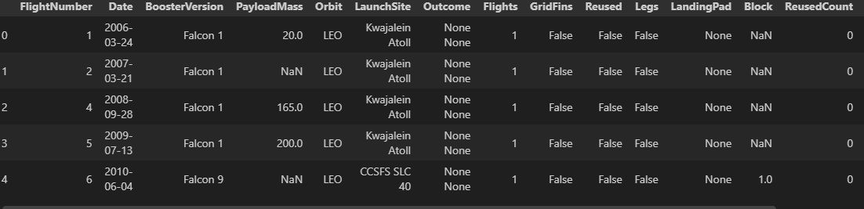
Data Collection – SpaceX API
Present your data collection with SpaceX REST calls using key phrases and flowcharts
https://github.com/gher123-ui/Spacex-capstone-project.git

Slide 9
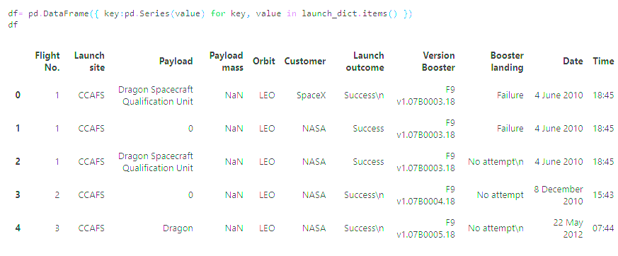
Data Collection - Scraping
Using BeautifulSoup, I request the URL and extract all the table names by iterating through the “<th>” elements. Then I created a dataframe by parsing the names of the tables.
https://github.com/gher123-ui/Spacex-capstone-project/blob/main/jupyter-labs-webscraping.ipynb

Slide 10
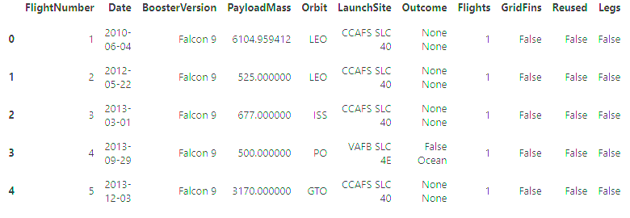
Data Wrangling
Did EDA to find things like occurrence, number of failed and successful launches, orbits, and then created labels for each outcome.
https://github.com/gher123-ui/Spacex-capstone-project/blob/main/labs-jupyter-spacex-Data%20wrangling.ipynb

Slide 11
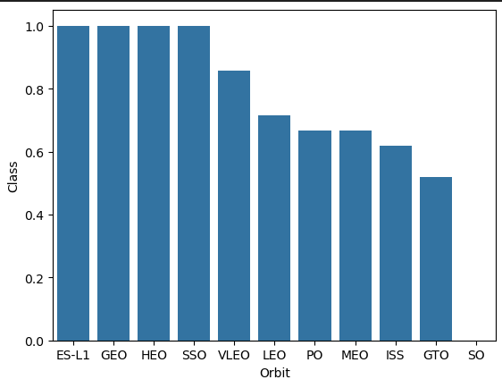
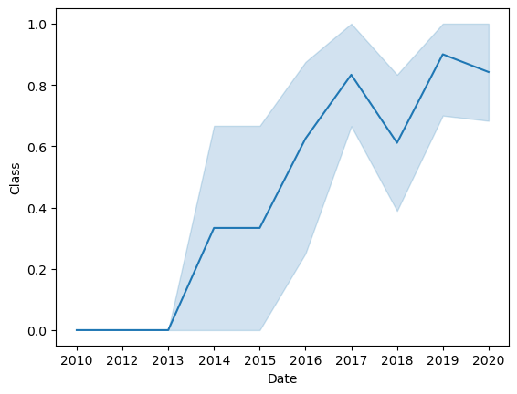
EDA with Data Visualization
One chart shows the success rate for each orbit and the other shows the success rate over the years.
https://github.com/gher123-ui/Spacex-capstone-project/blob/main/jupyter-labs-eda-dataviz-v2.ipynb

Slide 12
EDA with SQL
Loaded sql %load_ext sql
Total number of successful/ failed results and total payload
Booster version, date, orbit, and names of launch sites
https://github.com/gher123-ui/Spacex-capstone-project/blob/main/jupyter-labs-eda-sql-coursera_sqllite.ipynb

Slide 13
Build an Interactive Map with Folium
Added circles and markers for each of the launch sites. Every class had a different color and noticed that the launch sites are usually by the coast, one by California and the other by Florida.
https://github.com/gher123-ui/Spacex-capstone-project/blob/main/lab-jupyter-launch-site-location-v2.ipynb

Slide 14
Build a Dashboard with Plotly Dash
I used pie graphs and scatter graphs to show:
Total number of launches per site
Number of success vs failure of launch sites
Relationship between payload mass and class
https://github.com/gher123-ui/Spacex-capstone-project/blob/main/spacex-dash-app.py

Slide 15
Predictive Analysis (Classification)
Load the data using pandas, create an array using numpy, standardize data and split 80/20 into training and testing data respectfully
Use logistic regression, svm, decision tree, and knn to find the accuracy
https://github.com/gher123-ui/Spacex-capstone-project/blob/main/SpaceX-Machine-Learning-Prediction-Part-5-v1.ipynb

Slide 16
Results
Exploratory data analysis results
Interactive analytics demo in screenshots
Predictive analysis results

Slide 17

Section 2

Slide 18
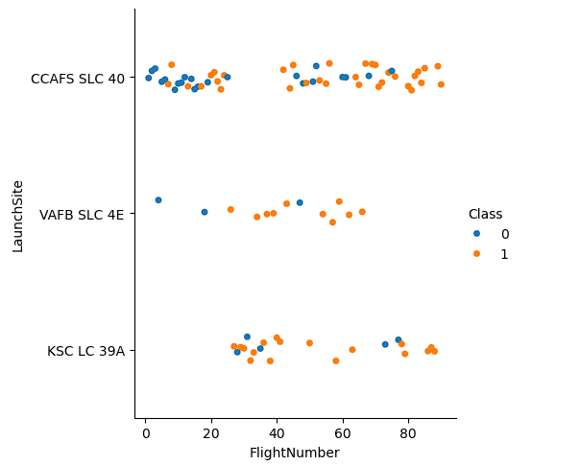
Flight Number vs. Launch Site
0 class represents failure and 1 class represents success
X axis shows the flight number and y axis shows the launch site
We can gather that more launches were successful at CCAFS SLC-40 with a higher flight number. KSC LC 39A doing the opposite, having more success at a lower flight number.

Slide 19
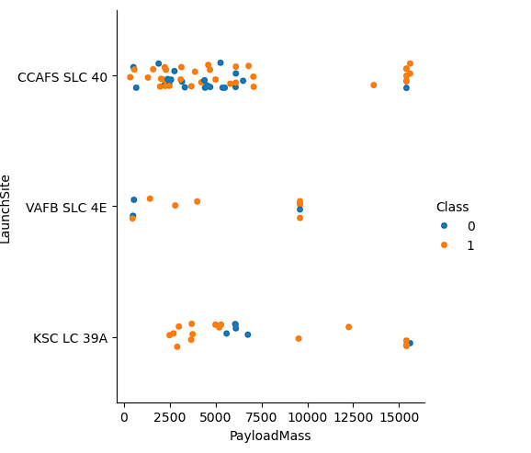
Payload vs. Launch Site
Payload mass less than 10,000 shows more successful launches overall with CCAFS having more launches at 15,000 and only having one failed launch.

Slide 20
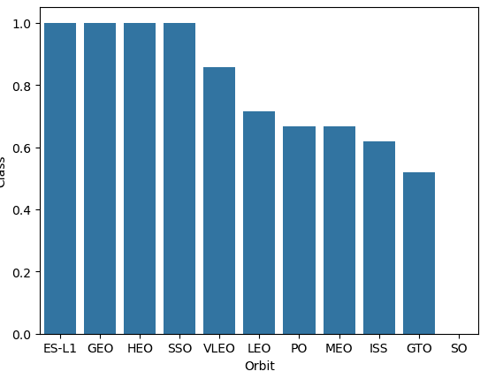
Success Rate vs. Orbit Type
The success rate for ES-L1, GEO, HEO, and SSO were the highest. Every other orbit fell a bit short.

Slide 21
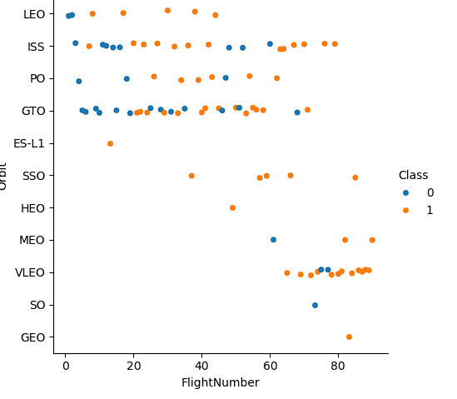
Flight Number vs. Orbit Type
More success is shown between flight number 20-60 except for VLEO having more success around the 60-80 range.

Slide 22
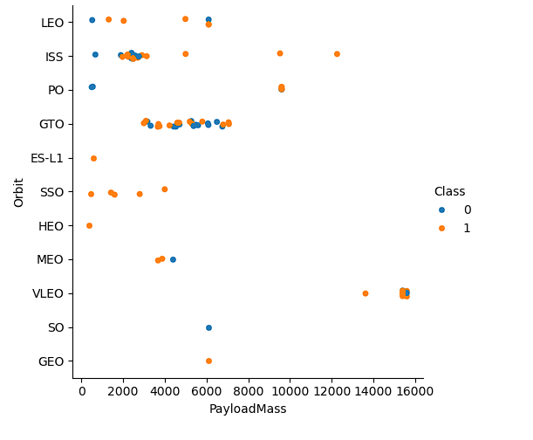
Payload vs. Orbit Type
SSO has more success with the least amount of payload mass, everyone else having mixed results between 2000-8000, again for VLEO being the exception with a payload mass of 16000 and having most of its success there.

Slide 23
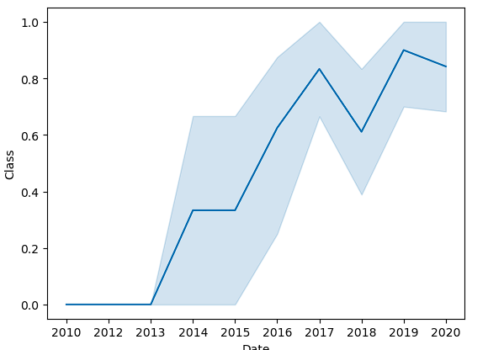
Launch Success Yearly Trend
The success rate gradually increased except for 2014 where it didn’t move, and 2017 and 2019 having decreased success.

Slide 24
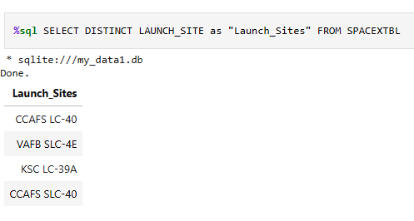
All Launch Site Names
Loading the data using pandas and then converting it to sql (df.to_sql), I was able to get the distinct names for all the launch sites using this code

Slide 25
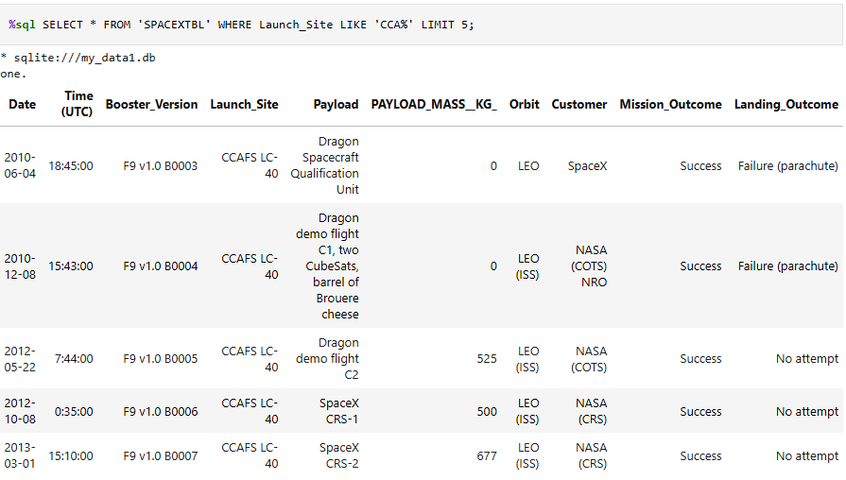
Launch Site Names Begin with 'CCA'
The data shows all the launch sites that start with the letters “CCA”, and limited to five rows.

Slide 26
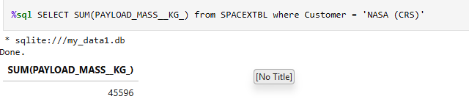
Total Payload Mass
This is the total number of payload mass in kgs where the boosters launched are specifically from NASA (CRS)

Slide 27
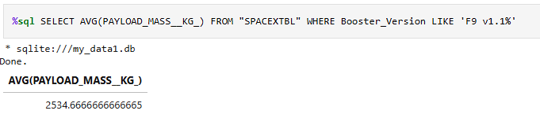
Average Payload Mass by F9 v1.1
This number shows the average payload mass in kgs where the booster version is F9 v1.1

Slide 28
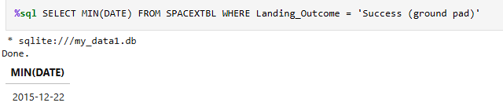
First Successful Ground Landing Date
To find the first successful landing outcome on ground pad I had to find the minimum date which is December 22nd, 2015

Slide 29
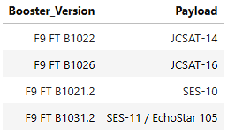
Successful Drone Ship Landing with Payload between 4000 and 6000
This chart below shows the booster version and the name of the payload where the mass of the payloads were anywhere between 4,000 kg and 6,000 kg

Slide 30
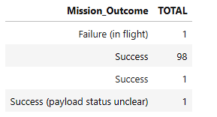
Total Number of Successful and Failure Mission Outcomes

Slide 31
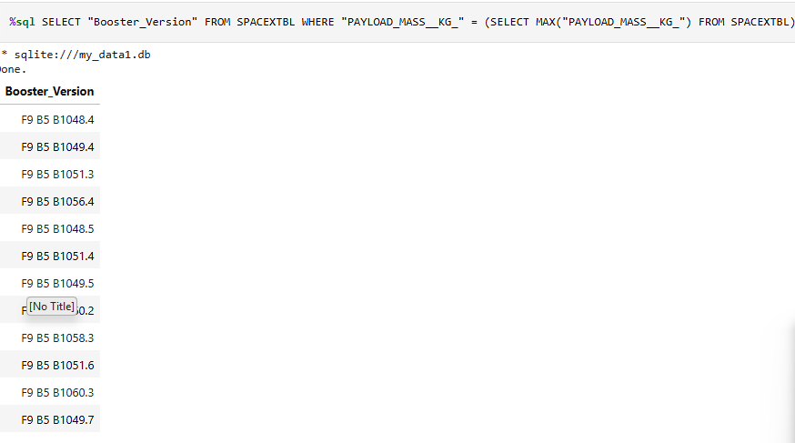
Boosters Carried Maximum Payload
Names of the booster version which carried the max payload

Slide 32
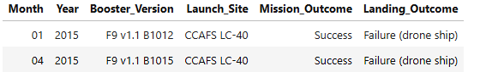
2015 Launch Records
Shown below are the names for launches in 2015 using substr(Date,6,2) to get the month and substr(Date,0,5) = ‘2015’ to get the specific year.

Slide 33
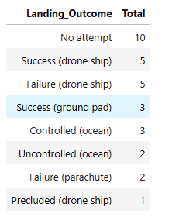
Rank Landing Outcomes Between 2010-06-04 and 2017-03-20
This is ranking the landing outcomes by total amount between the dates of 2018-06-04 and 2017-03-20

Slide 34

Section 3

Slide 35
<Folium Map Screenshot 1>
Replace <Folium map screenshot 1> title with an appropriate title
Explore the generated folium map and make a proper screenshot to include all launch sites’ location markers on a global map
Explain the important elements and findings on the screenshot

Slide 36
<Folium Map Screenshot 2>
Replace <Folium map screenshot 2> title with an appropriate title
Explore the folium map and make a proper screenshot to show the color-labeled launch outcomes on the map
Explain the important elements and findings on the screenshot

Slide 37
<Folium Map Screenshot 3>
Replace <Folium map screenshot 3> title with an appropriate title
Explore the generated folium map and show the screenshot of a selected launch site to its proximities such as railway, highway, coastline, with distance calculated and displayed
Explain the important elements and findings on the screenshot

Slide 38

Section 4

Slide 39
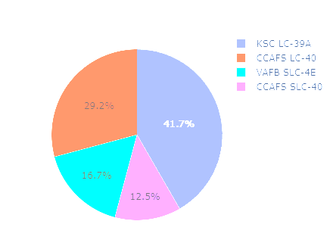
Total Success % By Launch Site
KSC LC-39A has shown more successful launches overall

Slide 40
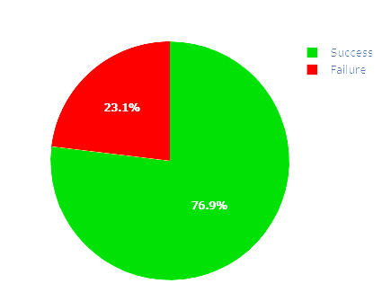
Highest launch success ratio
This is showing the success to failure ratio that KSC LC-39A has. It has the highest success percentage out of all the other launch sites.

Slide 41
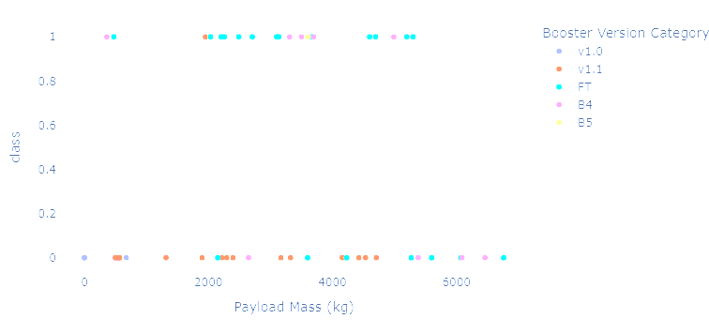
Payload Mass and Booster Version success/fail
The colors represent the booster version, on the bottom is the size of payload and the class is 0 for fail and 1 for success. Booster version FT shows the most success (KSC LC-39A)

Slide 42

Section 5

Slide 43
Classification Accuracy
I got about the same accuracy for all ways except for decision tree.

Slide 44
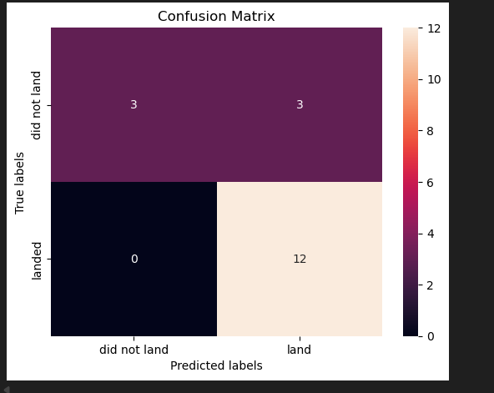
Confusion Matrix
This is the same for all except decision tree, but basically the number 12 is the true positive

Slide 45
Conclusions
KSC LC-39A showed more successful launches compared to the other launch sites
There has been a gradual increase in success since 2010, with the exception of some years having dips
Higher flight numbers had more success

Slide 46


